Slide 1
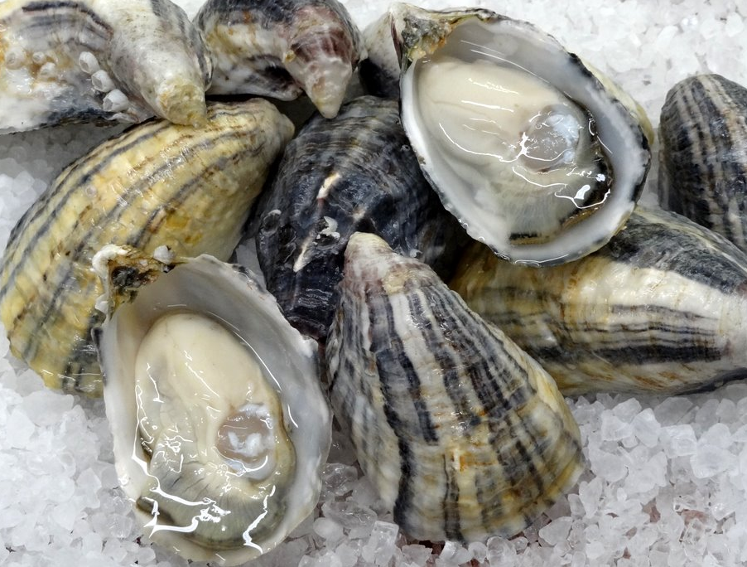
Exploring Proteomic Variation in Pacific Oysters
Yaamini Venkataraman
@YaaminiV

Slide 2

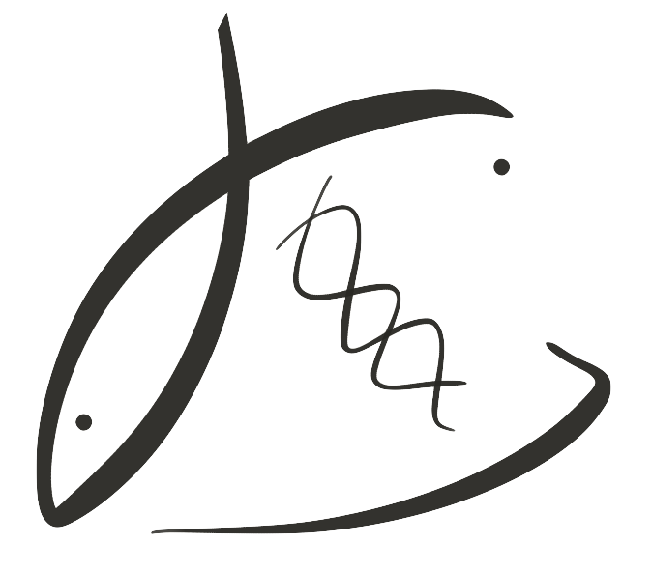

Outline
Title Photo from Willapa Oysters
Notes:
Just a quick rundown of what I’ll talk about today.
I think oysters are important, and first I hope to convince you of the same
Then I’ll go into the project’s research objectives
Explain the “why” or rationale behind these objectives
And then go into some predictions as to what we’ll see when we analyze our data

Slide 3
Outline
Introduction
Title Photo from Willapa Oysters
Notes:
Just a quick rundown of what I’ll talk about today.
I think oysters are important, and first I hope to convince you of the same
Then I’ll go into the project’s research objectives
Explain the “why” or rationale behind these objectives
And then go into some predictions as to what we’ll see when we analyze our data

Slide 4
Outline
Introduction
Research objectives
Title Photo from Willapa Oysters
Notes:
Just a quick rundown of what I’ll talk about today.
I think oysters are important, and first I hope to convince you of the same
Then I’ll go into the project’s research objectives
Explain the “why” or rationale behind these objectives
And then go into some predictions as to what we’ll see when we analyze our data

Slide 5
Outline
Introduction
Research objectives
Why?
Title Photo from Willapa Oysters
Notes:
Just a quick rundown of what I’ll talk about today.
I think oysters are important, and first I hope to convince you of the same
Then I’ll go into the project’s research objectives
Explain the “why” or rationale behind these objectives
And then go into some predictions as to what we’ll see when we analyze our data

Slide 6
Outline
Introduction
Research objectives
Why?
Preliminary Results
Title Photo from Willapa Oysters
Notes:
Just a quick rundown of what I’ll talk about today.
I think oysters are important, and first I hope to convince you of the same
Then I’ll go into the project’s research objectives
Explain the “why” or rationale behind these objectives
And then go into some predictions as to what we’ll see when we analyze our data

Slide 7
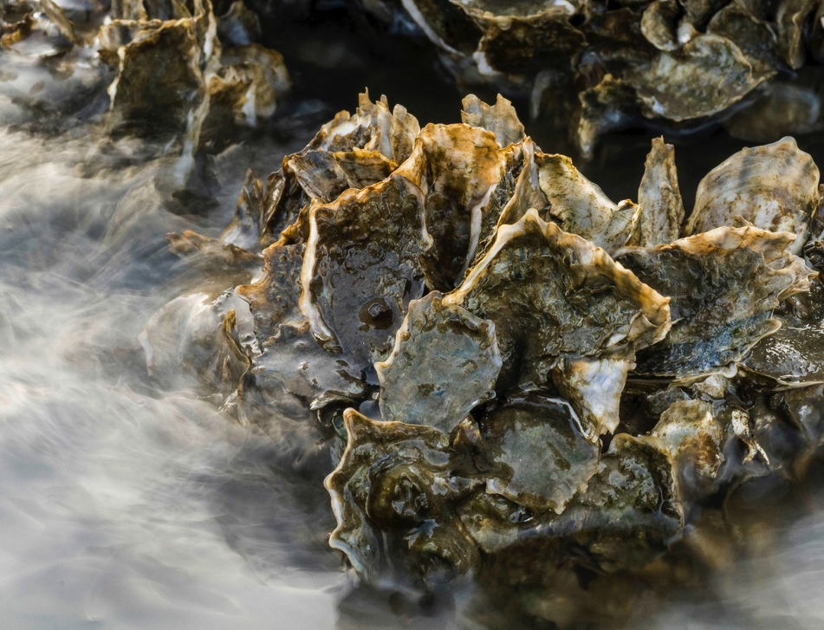
Oysters and the Ecosystem
Photo from The Nature Conservancy
Notes:
Oysters have a crucial role in the ecosystem
Oyster reefs provide fish habitat, stabilize our shorelines, and their filter feeding mechanism improves water quality and clarity
Heavily rely on oysters for aquaculture → of the nearly 25 million pounds of bivalves farmed in washington in 2013, 1/3 of that was the Pacific oyster, Crassostrea gigas (NOAA Washington Shellfish initiative)
Ecosystem services and aquaculture alike are threatened by climate change; specifically, ocean acidification and warming
Aren’t many studies that address multiple stressors for Pacific oysters in the wild

Slide 8
Oysters and the Ecosystem
fish habitat
Photo from The Nature Conservancy
Notes:
Oysters have a crucial role in the ecosystem
Oyster reefs provide fish habitat, stabilize our shorelines, and their filter feeding mechanism improves water quality and clarity
Heavily rely on oysters for aquaculture → of the nearly 25 million pounds of bivalves farmed in washington in 2013, 1/3 of that was the Pacific oyster, Crassostrea gigas (NOAA Washington Shellfish initiative)
Ecosystem services and aquaculture alike are threatened by climate change; specifically, ocean acidification and warming
Aren’t many studies that address multiple stressors for Pacific oysters in the wild

Slide 9
Oysters and the Ecosystem
fish habitat
shoreline stabilization
Photo from The Nature Conservancy
Notes:
Oysters have a crucial role in the ecosystem
Oyster reefs provide fish habitat, stabilize our shorelines, and their filter feeding mechanism improves water quality and clarity
Heavily rely on oysters for aquaculture → of the nearly 25 million pounds of bivalves farmed in washington in 2013, 1/3 of that was the Pacific oyster, Crassostrea gigas (NOAA Washington Shellfish initiative)
Ecosystem services and aquaculture alike are threatened by climate change; specifically, ocean acidification and warming
Aren’t many studies that address multiple stressors for Pacific oysters in the wild

Slide 10
Oysters and the Ecosystem
fish habitat
shoreline stabilization
water filtration
Photo from The Nature Conservancy
Notes:
Oysters have a crucial role in the ecosystem
Oyster reefs provide fish habitat, stabilize our shorelines, and their filter feeding mechanism improves water quality and clarity
Heavily rely on oysters for aquaculture → of the nearly 25 million pounds of bivalves farmed in washington in 2013, 1/3 of that was the Pacific oyster, Crassostrea gigas (NOAA Washington Shellfish initiative)
Ecosystem services and aquaculture alike are threatened by climate change; specifically, ocean acidification and warming
Aren’t many studies that address multiple stressors for Pacific oysters in the wild

Slide 11
Oysters and the Ecosystem
fish habitat
shoreline stabilization
water filtration
aquaculture
Photo from The Nature Conservancy
Notes:
Oysters have a crucial role in the ecosystem
Oyster reefs provide fish habitat, stabilize our shorelines, and their filter feeding mechanism improves water quality and clarity
Heavily rely on oysters for aquaculture → of the nearly 25 million pounds of bivalves farmed in washington in 2013, 1/3 of that was the Pacific oyster, Crassostrea gigas (NOAA Washington Shellfish initiative)
Ecosystem services and aquaculture alike are threatened by climate change; specifically, ocean acidification and warming
Aren’t many studies that address multiple stressors for Pacific oysters in the wild

Slide 12
How does environmental variability affect C. gigas’ physiological response?
Notes:
For these reasons, I’m asking the question: How does environmental variability affect the Pacific oyster’s physiological response?
Will there be differences in reproduction and immunity?
We know eelgrass modifies water chemistry where it’s located: can eelgrass presence or absence in oyster beds shape these outcomes?
Can we detect differences on an epigenetic and proteomic level?

Slide 13
How does environmental variability affect C. gigas’ physiological response?
Differences in stress response?
Notes:
For these reasons, I’m asking the question: How does environmental variability affect the Pacific oyster’s physiological response?
Will there be differences in reproduction and immunity?
We know eelgrass modifies water chemistry where it’s located: can eelgrass presence or absence in oyster beds shape these outcomes?
Can we detect differences on an epigenetic and proteomic level?

Slide 14
How does environmental variability affect C. gigas’ physiological response?
Differences in stress response?
How can eelgrass presence shape these outcomes?
Notes:
For these reasons, I’m asking the question: How does environmental variability affect the Pacific oyster’s physiological response?
Will there be differences in reproduction and immunity?
We know eelgrass modifies water chemistry where it’s located: can eelgrass presence or absence in oyster beds shape these outcomes?
Can we detect differences on an epigenetic and proteomic level?

Slide 15
How does environmental variability affect C. gigas’ physiological response?
Differences in stress response?
How can eelgrass presence shape these outcomes?
Can we detect differences in protein expression?
Notes:
For these reasons, I’m asking the question: How does environmental variability affect the Pacific oyster’s physiological response?
Will there be differences in reproduction and immunity?
We know eelgrass modifies water chemistry where it’s located: can eelgrass presence or absence in oyster beds shape these outcomes?
Can we detect differences on an epigenetic and proteomic level?

Slide 16
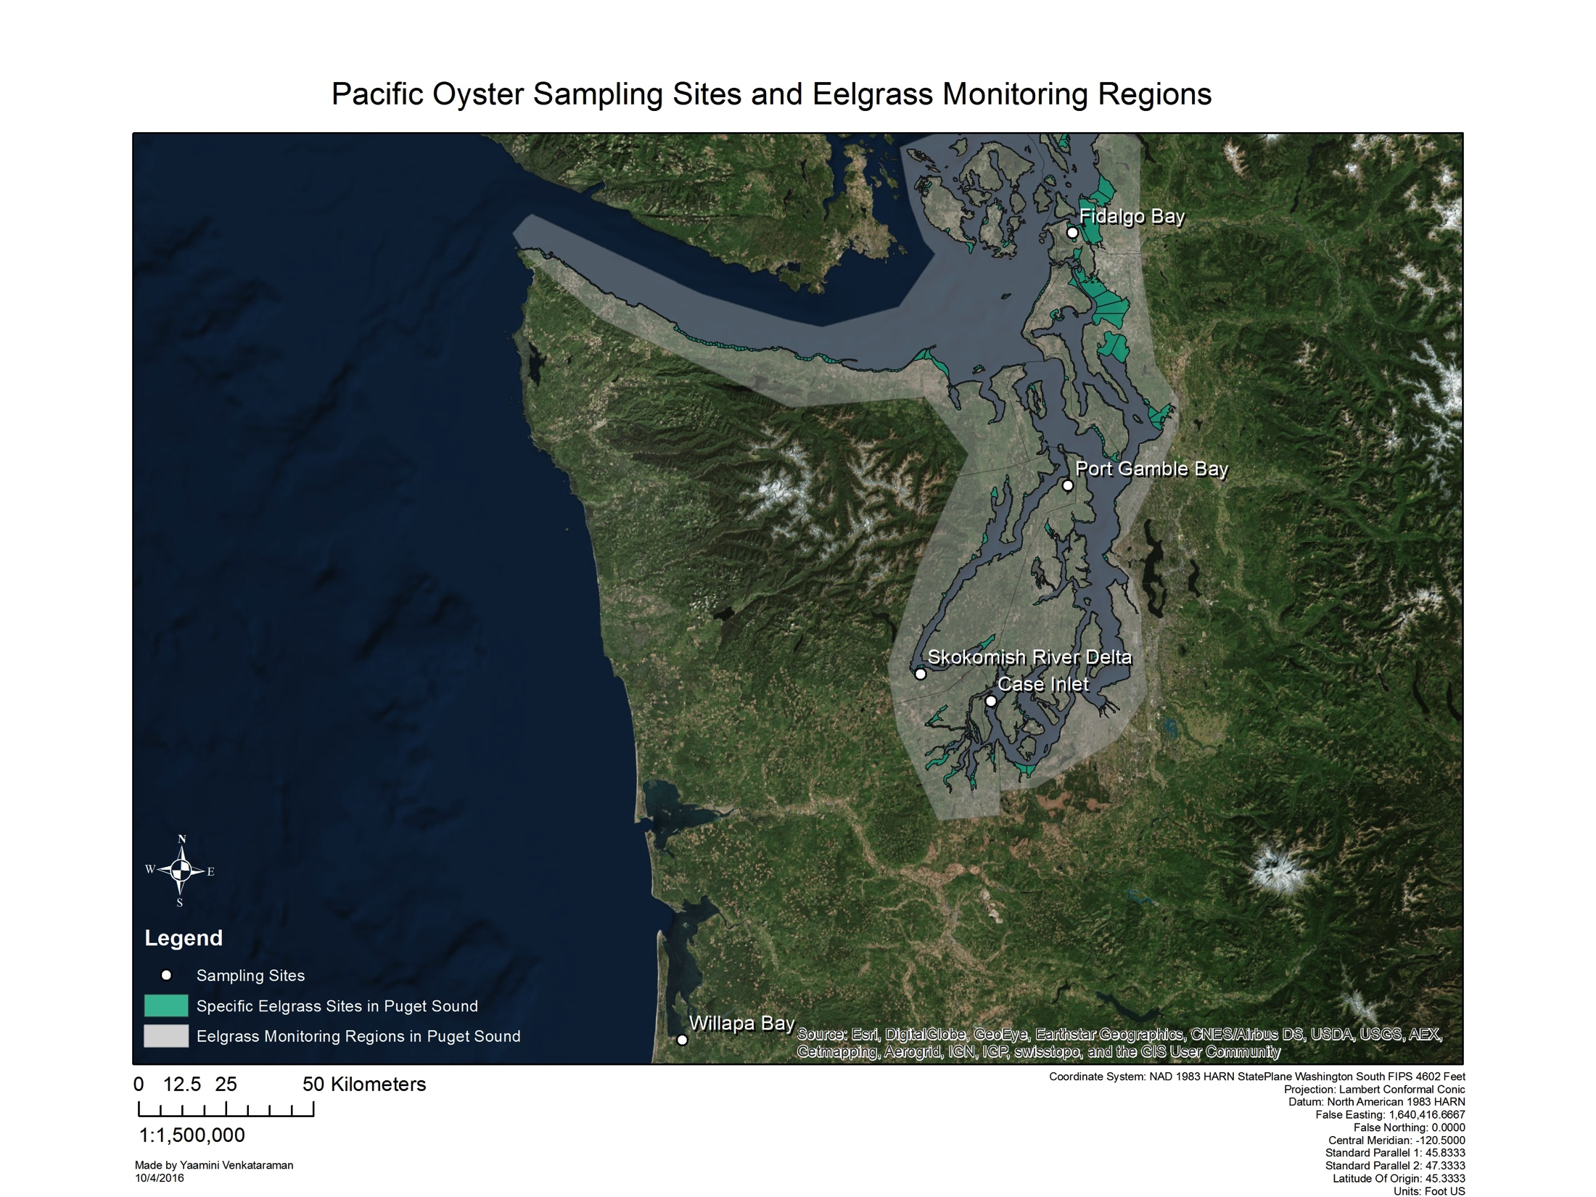
Environmental Variability
5 sample sites
Notes:
First, let me explain the environmental variability we’re working with
We chose 5 sample sites in and around Puget Sound: Fidalgo Bay, Port Gamble Bay, Skokomish River delta, case inlet and willapa bay
All five of these sites have eelgrass present

Slide 17
Environmental Variability
5 sample sites
Fidalgo Bay (FB)
Notes:
First, let me explain the environmental variability we’re working with
We chose 5 sample sites in and around Puget Sound: Fidalgo Bay, Port Gamble Bay, Skokomish River delta, case inlet and willapa bay
All five of these sites have eelgrass present

Slide 18
Environmental Variability
5 sample sites
Fidalgo Bay (FB)
Port Gamble Bay (PG)
Notes:
First, let me explain the environmental variability we’re working with
We chose 5 sample sites in and around Puget Sound: Fidalgo Bay, Port Gamble Bay, Skokomish River delta, case inlet and willapa bay
All five of these sites have eelgrass present

Slide 19
Environmental Variability
5 sample sites
Fidalgo Bay (FB)
Port Gamble Bay (PG)
Skokomish River Delta (SK)
Notes:
First, let me explain the environmental variability we’re working with
We chose 5 sample sites in and around Puget Sound: Fidalgo Bay, Port Gamble Bay, Skokomish River delta, case inlet and willapa bay
All five of these sites have eelgrass present

Slide 20
Environmental Variability
5 sample sites
Fidalgo Bay (FB)
Port Gamble Bay (PG)
Skokomish River Delta (SK)
Case Inlet (CI)
Notes:
First, let me explain the environmental variability we’re working with
We chose 5 sample sites in and around Puget Sound: Fidalgo Bay, Port Gamble Bay, Skokomish River delta, case inlet and willapa bay
All five of these sites have eelgrass present

Slide 21
Environmental Variability
5 sample sites
Fidalgo Bay (FB)
Port Gamble Bay (PG)
Skokomish River Delta (SK)
Case Inlet (CI)
Willapa Bay (WB)
Notes:
First, let me explain the environmental variability we’re working with
We chose 5 sample sites in and around Puget Sound: Fidalgo Bay, Port Gamble Bay, Skokomish River delta, case inlet and willapa bay
All five of these sites have eelgrass present

Slide 22
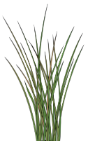
Experimental Overview
150 oysters
outplant to 5 sites
3 replicates
eelgrass vs. no eelgrass
Notes:
At each of the sites, our sampling scheme was as follows:
From 150 total oysters
Took 2 sets of 5 oysters → put them in cages to protect them from predation → 3 replicates, 6 cages total
Outplanted 6 cages at each of our 5 sites → 3 in eelgrass, 3 outside of eelgrass
Measured temperature, dissolved oxygen continuously for a month while oysters were out there from june to july
One thing I’ve alluded to during the presentation is the potential effect of eelgrass presence. Returning back to the map of our sampling sites, you can see that the DNR has been monitoring much of the Puget Sound region for eelgrass (white), with specific eelgrass beds indicated in green.

Slide 23
Differences in environmental variability and eelgrass presence will affect protein expression.
Notes:
Differences in environmental variability and eelgrass presence will affect epigenetic and proteomic responses.
How can we test this?

Slide 24
Differences in environmental variability and eelgrass presence will affect protein expression.
How can we test this?
Notes:
Differences in environmental variability and eelgrass presence will affect epigenetic and proteomic responses.
How can we test this?

Slide 25
Mass Spectrometry
Notes:
Can look at DNA and proteins!

Slide 26
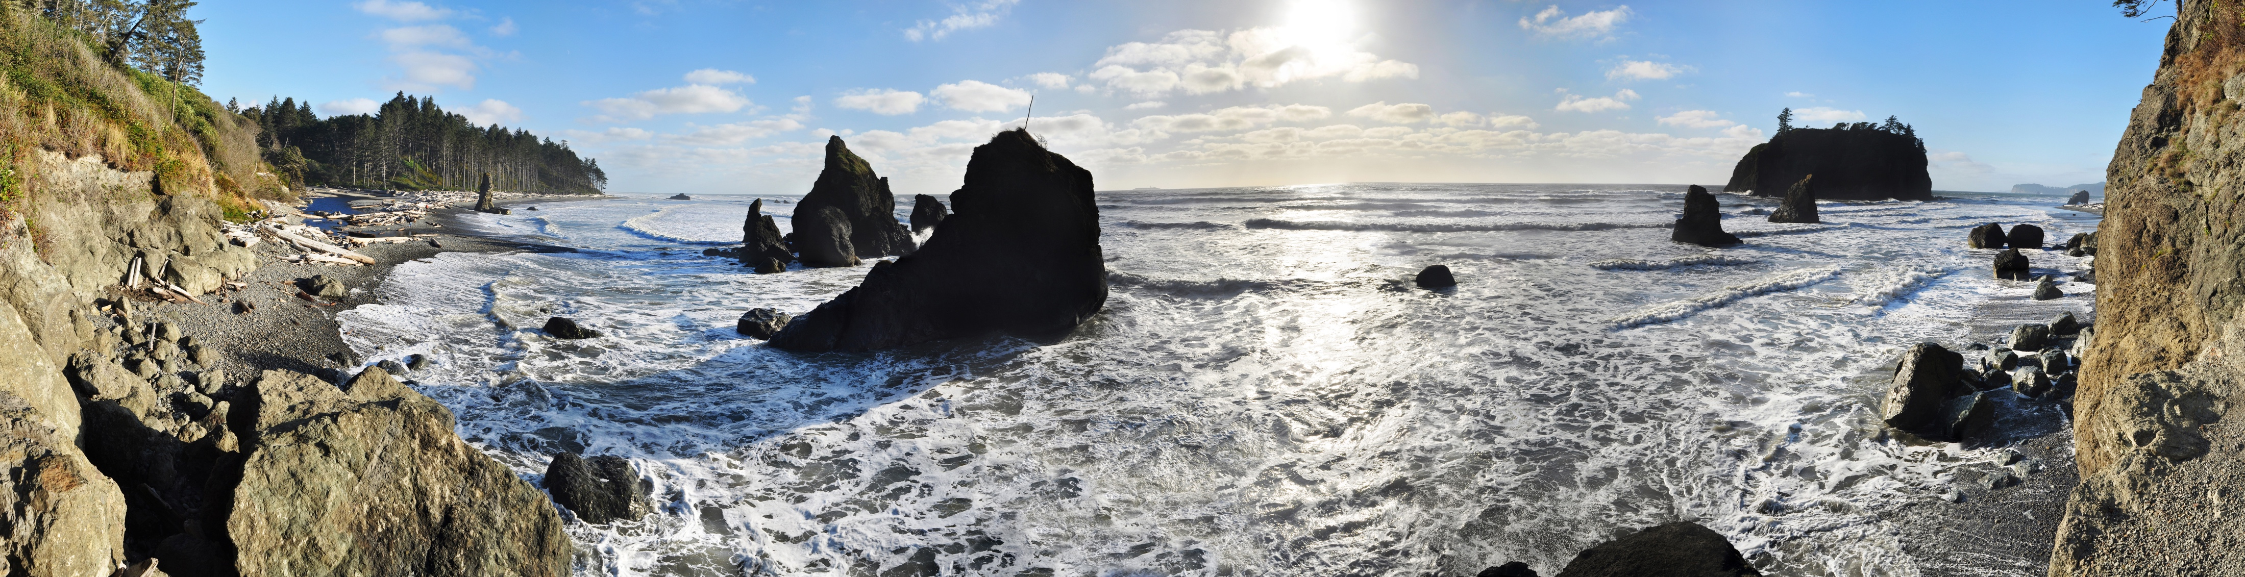
Mass Spectrometry
Shotgun proteomics:
What proteins are there?
Notes:
Can look at DNA and proteins!

Slide 27
Mass Spectrometry
Shotgun Proteomics:
What proteins are there?
Selected Reaction Monitoring: What are we interested in?

Slide 28
Shotgun Proteomics
10 samples, 1from each site and habitat type

Slide 29
Shotgun Proteomics
10 samples, 1from each site and habitat type
9,047 proteins identified

Slide 30
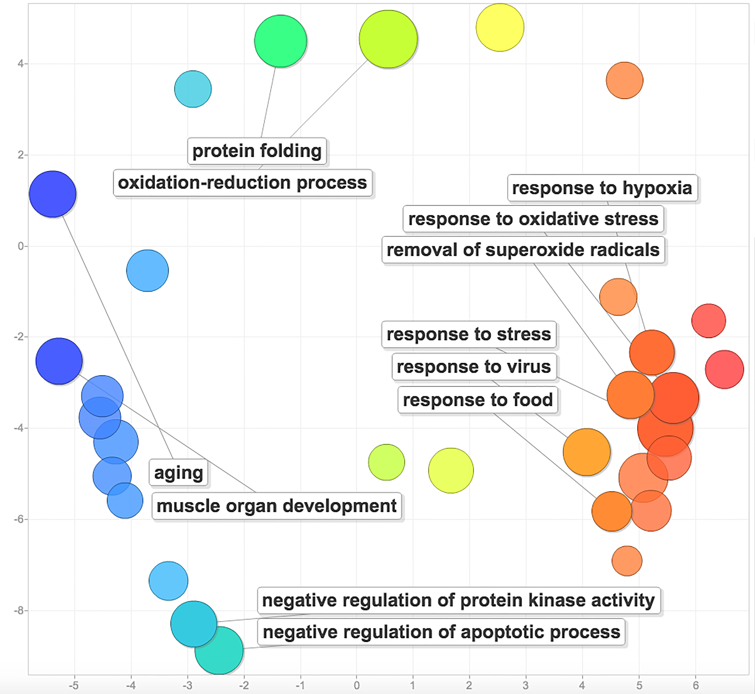
Shotgun Proteomics
10 samples, 1from each site and habitat type
9,047 proteins identified

Slide 31
Shotgun Proteomics
10 samples, 1from each site and habitat type
9,047 proteins identified
Stress-related protein functions represented

Slide 32
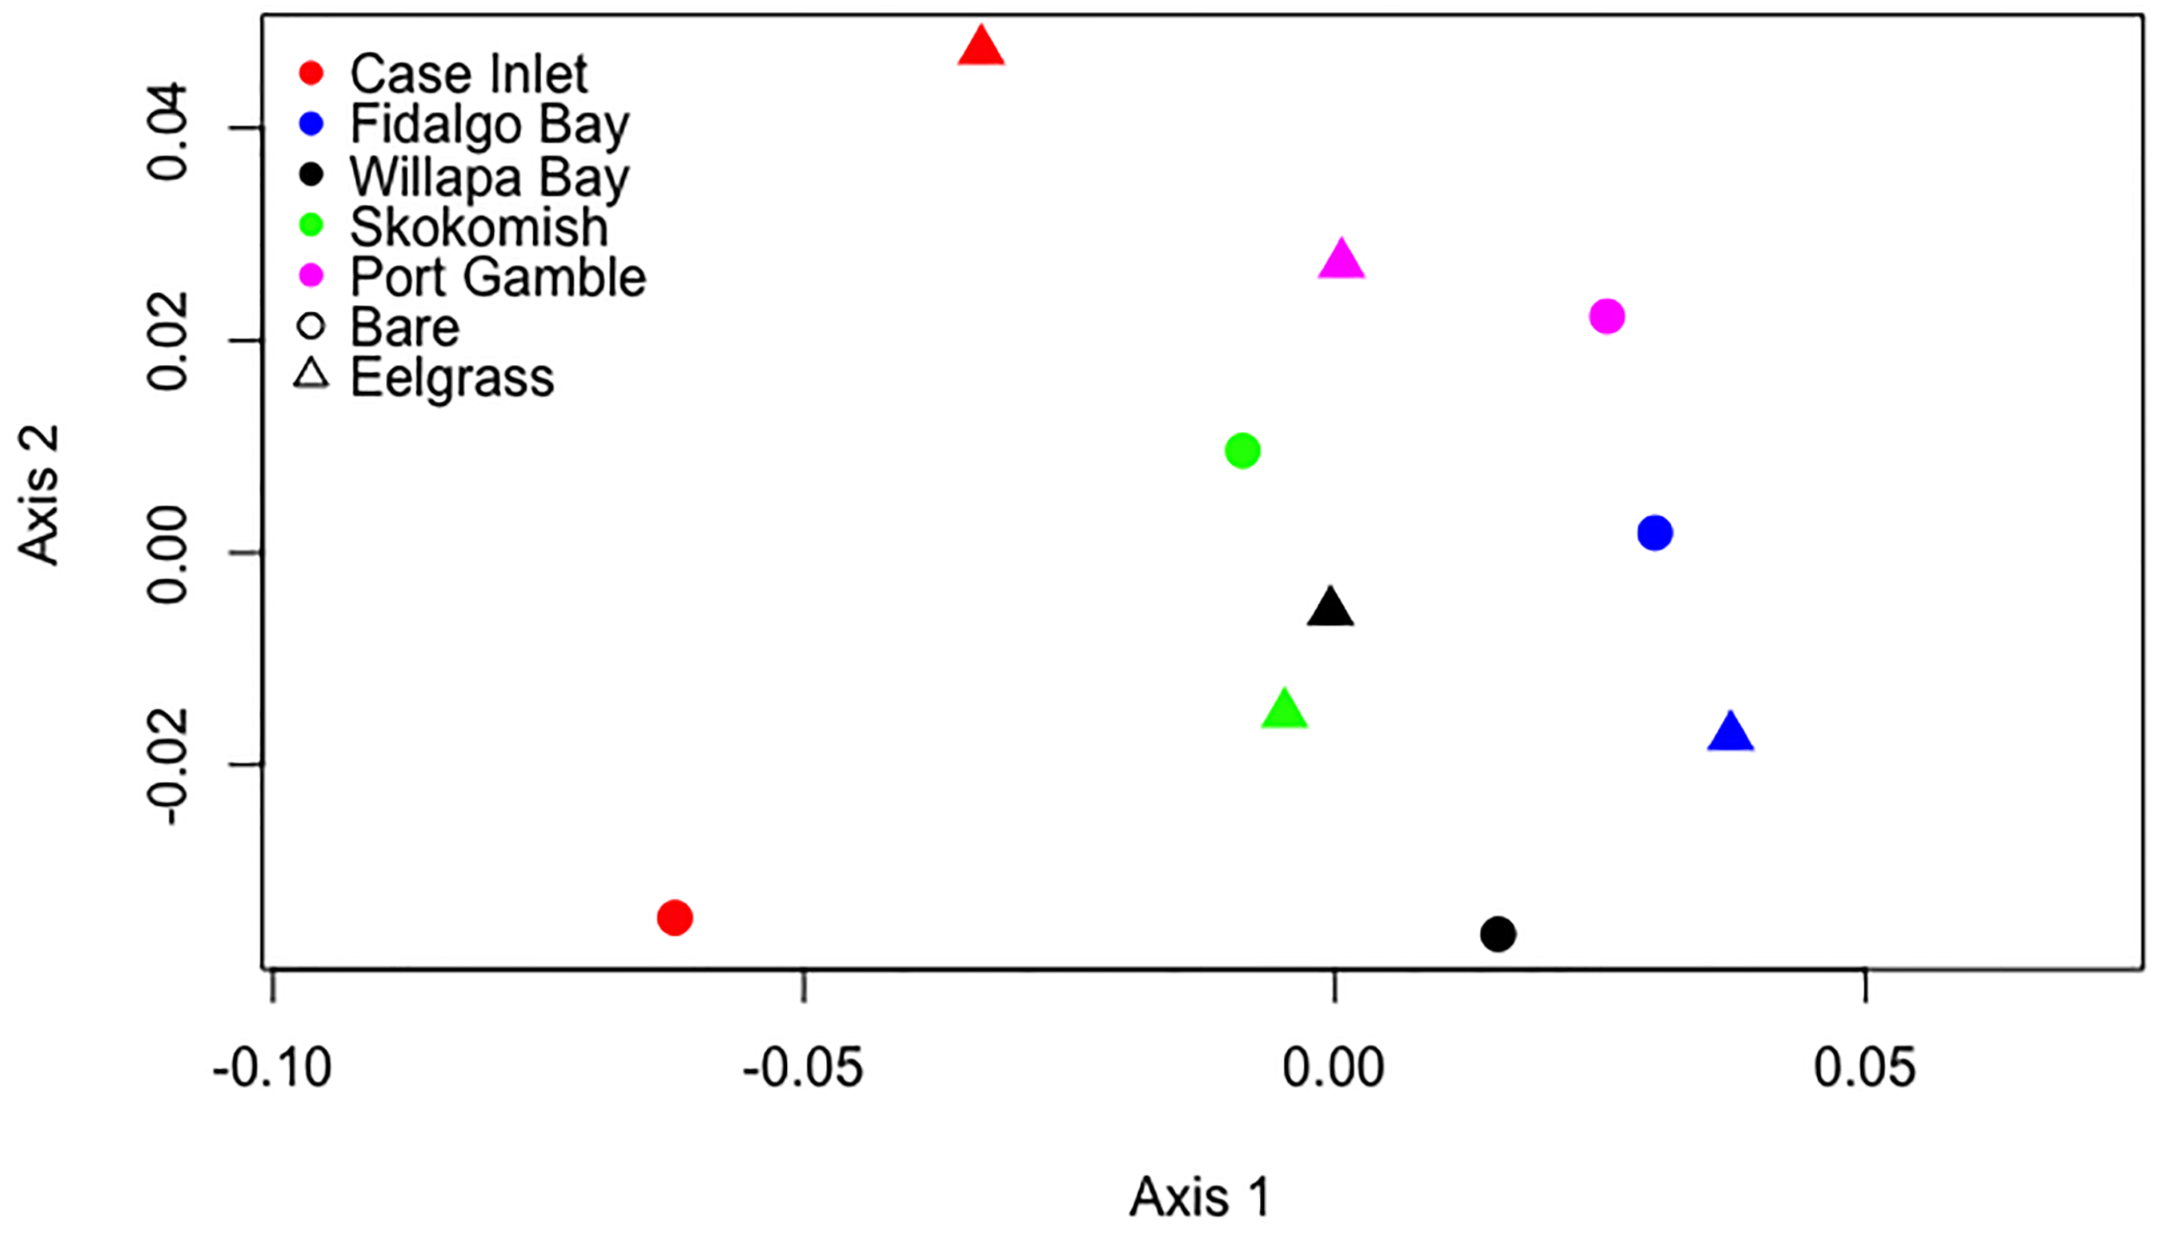
Shotgun Proteomics
10 samples, 1from each site and habitat type
9,047 proteins identified
Stress-related protein functions represented
Possible site effect?

Slide 33
Identifying Targets
Use protein annotations and data quality

Slide 34
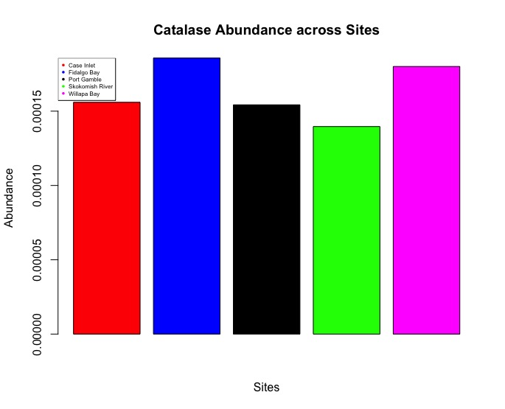
Preliminary Results
Magic will happen here when I figure out why R hates me!
Plan: Average data by site and examine protein differences (since we have some indication that there’s a data trend there)
How can I spin my lack of actual results?
How can I ensure this talk is not a carbon copy of Laura’s since our projects are 99% similar?

Slide 35
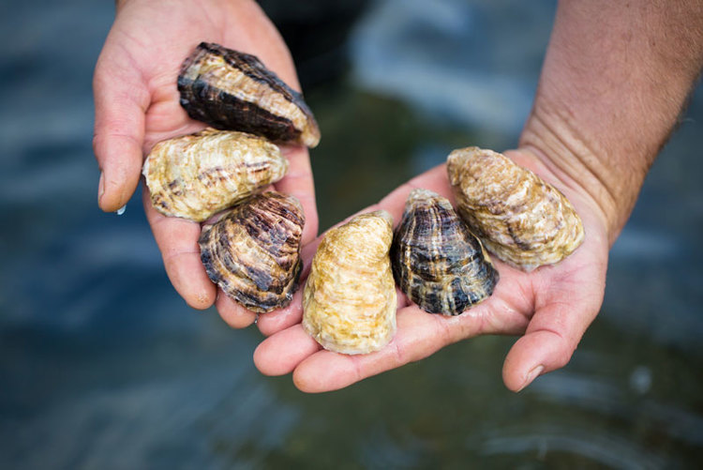
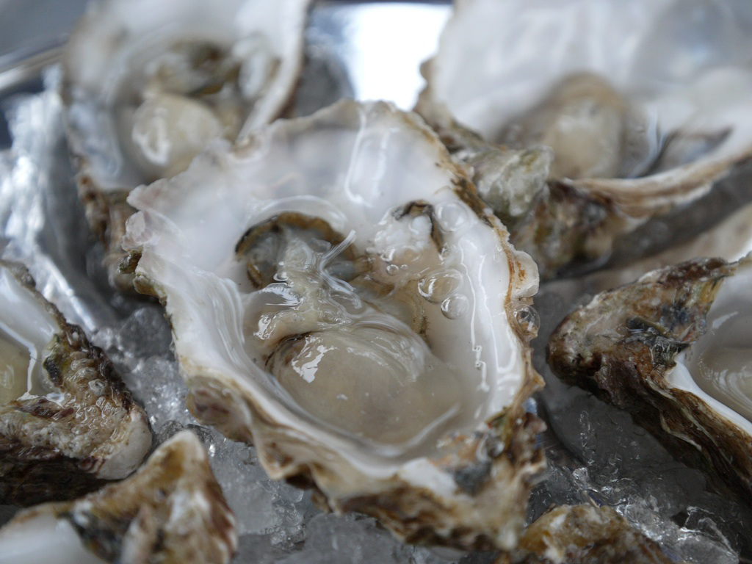
Looking Forward
Use multivariate techniques to analyze data
Understand how environmental variables affect protein expression
Photo from Capital Oysters
Photo from World Media Foundation

Slide 36
Thank You!
Yaamini Venkataraman
yaaminiv@uw.edu
http://bit.ly/project-oyster-oa

Slide 37
Experimental Overview
150 oysters
outplant to 5 sites
3 replicates
eelgrass vs. no eelgrass
Water chemistry data (temperature, dissolved oxygen)
Protein extraction
Notes:
Can look at DNA and proteins!

Slide 38
Eelgrass Presence
Increased photosynthesis
Decreased photosynthesis
Does eelgrass impact respiration physiology?
Positive: Decreased expression of proteins involved in oxidative stress
Negative: Increased expression of proteins involved in oxidative stress
Notes:
Eelgrass photosynthesis and respiration can locally impact water chemistry
In this very rough mock representation, you can see how dissolved oxygen content varies daily
As sunlight reaches eelgrass beds, they photosynthesize more, leading to increased dissolved oxygen content
The opposite is true as the beds receive less sunlight and start to photosynthesize less
Because eelgrass can modify water chemistry in a way that fluctuates on a daily cycle, oysters’ physiological response to these fluctuations has interesting potential
Does eelgrass impact respiration physiology?
If organisms benefit from fluctuations, we expect, amongst other indicators, decreased expression of proteins involved in oxidative stress
Opposite true if fluctuations negatively impact organisms

